Slide 1

MARAKAS FASHION
GOOD CUSTOMERS MARKETING STRATEGY
Notes:
https://pixabay.com/en/macbook-apple-imac-computer-screen-606763/

Slide 2

OUTLINE
Introduction
Presenting our data and methodology
Good customer profile
Showing what the typical good customer looks like and its subgroups
Marketing strategy
Defining different strategies for the different good customers
Conclusion
Wrapping up our results and recommendations
Notes:
https://pixabay.com/en/chairs-conference-room-long-table-1840377

Slide 3
INTRODUCTION
CONTEXT, METHODOLOGIES
AND DATA SET
Notes:
https://pixabay.com/en/macbook-apple-imac-computer-screen-606763/

Slide 4
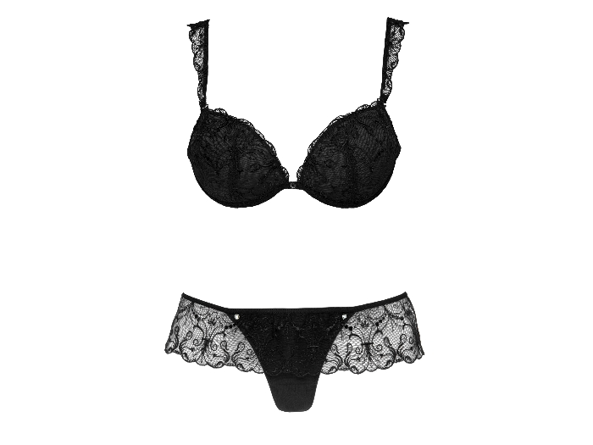
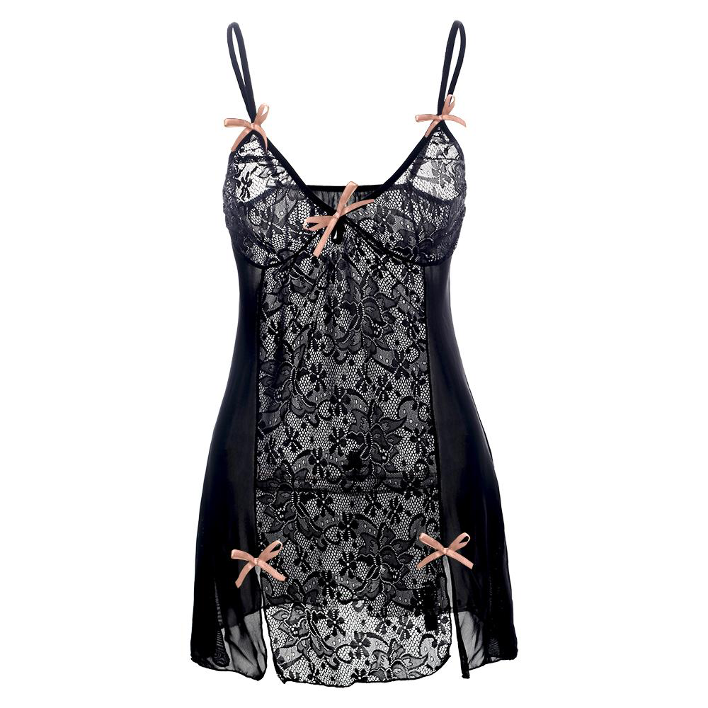
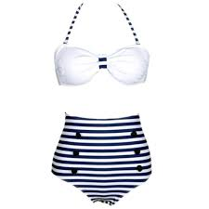
Our Products
Marakas Fashion is a French retailer company specialised in women’s fashion
Underwear
Sleepwear
Beachwear

Slide 5
Overall Objective
Main Goal: Turn Good Customers into Top Customers
To do so, we build marketing strategies to increase:
-Cross-selling and Up-selling
-Customer retention
1. What is cross-selling?
It is the action of selling an additional product to an existing customer.
2. What is up-selling?
Business tries to persuade customers to buy an additional item in order to make a more profitable sale.
3. Customer retention?
It refers to the activities and actions that companies take to reduce the number of customer defections. The goal of customer retention programs is to help companies retain as many customers as possible.

Slide 6
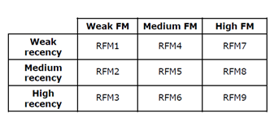
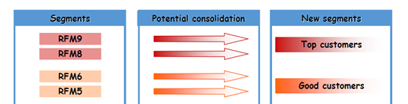
Our Methodology
RFM Segmentation
It is based on three variables: Recency, Frequency and Monetary value.
We use the RFM segmentation method to separate the customers into nine groups.
First, we use the frequency and monetary values table with the level weak medium and high to get the FM segmentation.
Then we add the recency into the FM segmentation table to get a complete RFM segmentation.

Slide 7
Our Methodology
2. Descriptive Analysis
We use this method to:
Give a precise description on the Good Customers profile compared with others.
Compare Good Customers with Top Customers.
3. Clustering Analysis
It consists of splitting a given population into subgroups with specific characteristics
We use this method to:
Get a better understanding of the Good Customers behaviours.
Find the best marketing strategies to turn them into Top Customers.

Slide 8
Data Description
The source of the data came from purchase information of the company for one year.
The raw data file contains 35,960 customers and 32 variables.
There are 16,512 active customers and 19,443 inactive customers;
From the RFM analysis build on the active customers, we get a new classification of our customers: Top, Good, Decelerations, Small, Weak, and New customers.
Throughout this work, we are going to:
- Study the Good customers compare with total,
- Compare Good customers and Top customers,
- Give Marketing Strategies to transform Good Customers into Top Customers.

Slide 9
GOOD CUSTOMER PROFILE
WHAT’S A GOOD CUSTOMER?
Notes:
https://pixabay.com/en/macbook-apple-imac-computer-screen-606763/

Slide 10
Good Customer Profile
What is a Good Customer?
Average combination of buying frequency and monetary value:
- If Frequency is high, Monetary value is low
- If Frequency is medium, Monetary value is medium
- If Frequency is low, Monetary value is high
Last purchase was less than 277 days ago (recency)

Slide 11

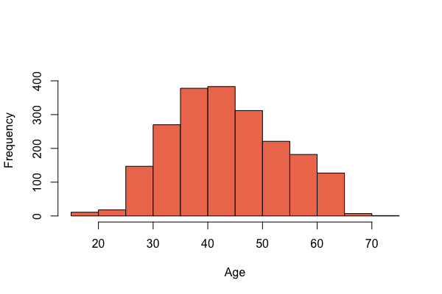
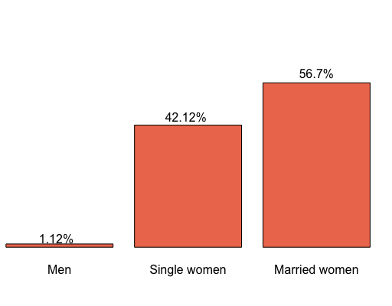
Good Customer Profile
Good Customer Characteristics?
Number of clients: 2215 (13.4% of the total)
98.8% women

Slide 12
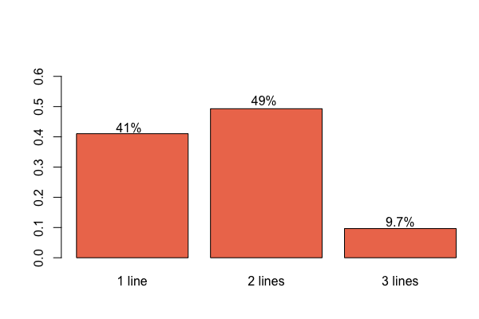
Good Customer Profile
Good Customer buying habits
3 visits per year
118 € per visit
3 - 4 products per visit

Slide 13
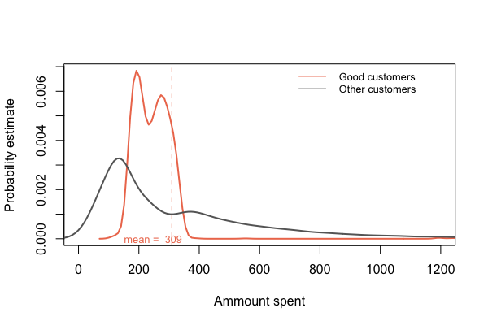
Good Customer Profile

Slide 14
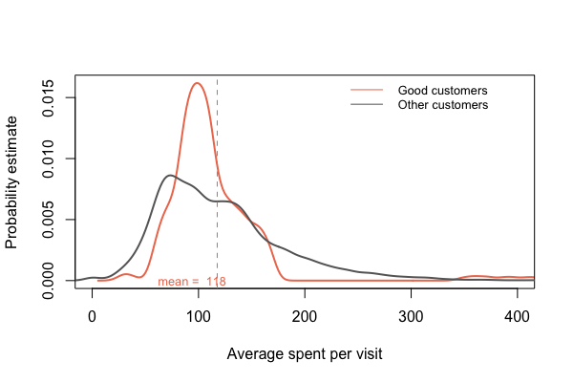
Good Customer Profile

Slide 15
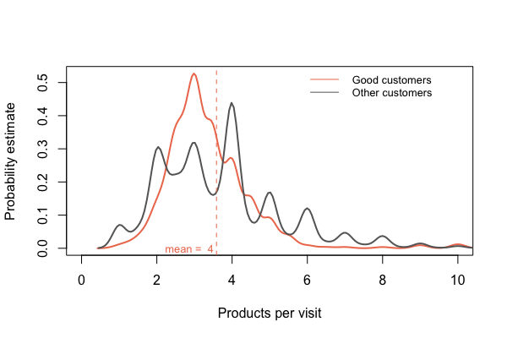
Good Customer Profile

Slide 16
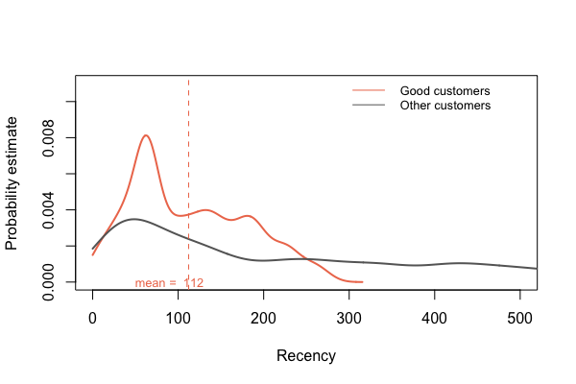
Good Customer Profile

Slide 17
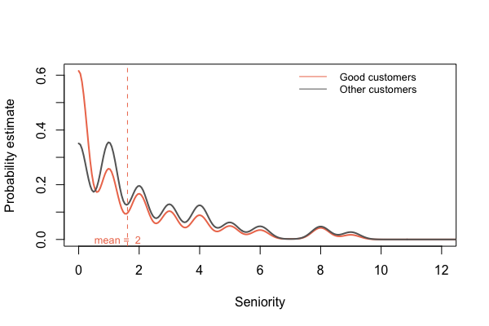
Good Customer Profile

Slide 18
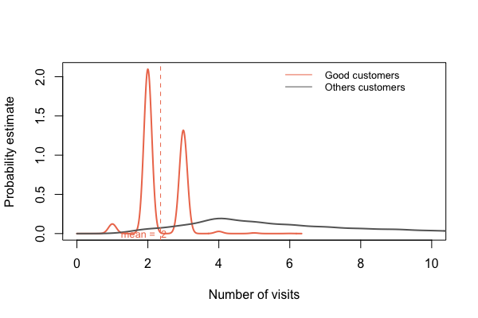
Good Customer Profile

Slide 19

Good Customer Persona
Sandrine, 44 years old
Lives in Provence
Married
Prefers to shop in the city center than to go to a mall
Joined our loyalty program a year ago
Has been to Maraka’s 3 times since then

Slide 20
GOOD CUSTOMERS
Vs
TOP CUSTOMERS
Notes:
https://pixabay.com/en/macbook-apple-imac-computer-screen-606763/

Slide 21
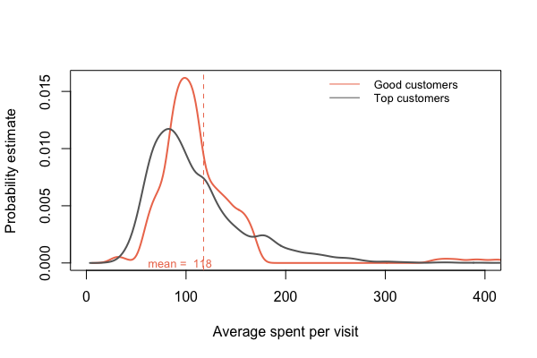
Good Customers VS Top Customers

Slide 22
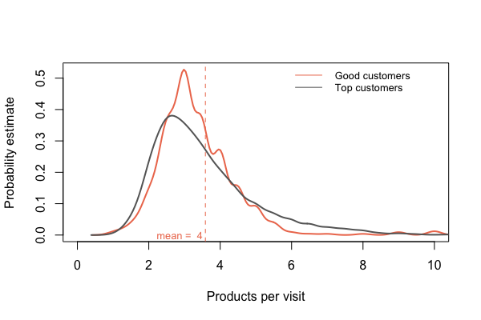
Good Customers VS Top Customers

Slide 23
Good Customers VS Top Customers
Purchase variety
Average number of different product lines bought:
Good customers: 1.7
Top customers: 2.3
Average number of different product families:
Good customers: 4.3
Top customers: 7.2
Conclusion: push a wider variety of products to good customers

Slide 24
GOOD CUSTOMERS BEHAVIOUR
CAN WE SPLIT THEM INTO SUBGROUPS?
Notes:
https://pixabay.com/en/macbook-apple-imac-computer-screen-606763/

Slide 25
Good Customer Behaviour
Clustering Analysis
Group 1
Group 2
Group 3
1.242 customers
They have joined the loyalty program long ago (around 2 years) and they’ve been to the store recently (61 days ago).
They don’t spend much in every visit (around 100 euros).
Goal: make them spend more in each visit, by buying more products.
897 customers
They have joined the loyalty program recently, but haven’t been to the store lately. They also don’t spend much during their visits.
Goal: bring them to the store and make them spend more buy buying more products.
76 customers
Very recent customers (2 months), but have spent a lot on each visit (around € 430), on a variety of products (around 12). Most of them are Married and live in Paris than in Provence. They also buy more often in the city centre than in a shopping mall.
Goal: bring them to the store.

Slide 26
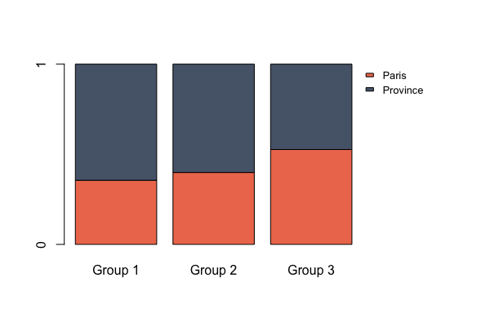
Good Customer Behaviour
Clustering

Slide 27
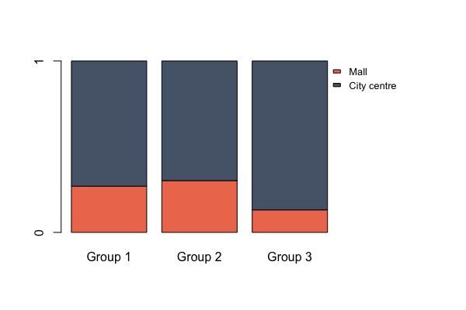
Good Customer Profile
Clustering

Slide 28
MARKETING STRATEGY
HOW TO ADDRESS THE DIFFERENT GOOD CUSTOMER TYPES?
Notes:
https://pixabay.com/en/macbook-apple-imac-computer-screen-606763/

Slide 29
Marketing Strategy
To bring them to the store
Click and collect: buy online and pick it up at the store;
CRM: Automatic emails when they buy something, offering a discount for next time, or when there's a new collection or sale, with products they might like, based on their previous purchases.
Special campaigns for men on valentine's day, pushing the top products in lingerie -Contact the men of group 3 by phone and send an email to every mens
Boost Instagram

Slide 30
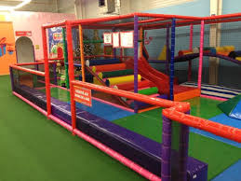
Marketing Strategy
To make them spend more
Make the stores kids-friendly, so their moms can spend more time shopping:
e.g: create safe playground for children

Slide 31


Marketing Strategy
To make them spend more
Delivery service: they shop at the store and we deliver the bags to their homes or office.
To make them buy all the 3 lines products: during Christmas days, Valentine’s days and other festive days, we create a ‘’Mystery box’’ containing the three lines of products (of same size) with a slight reduction of the price.
We can make advertisement with these mystery boxes to make them buy it more

Slide 32
Marketing Strategy
To make them spend more
Review our return policies:
Our customers have up to 1 week to return a product (from 10€) in good conditions.
Small gifts for the most expensive products in each line/family
Offer to split payment throughout several months
Change stores layout:
Since most of the Good customers shop in the city center (72%) and in Province (62%), then we can:
- increase the size of the existing stores there,
- create new stores in Province

Slide 33
CONCLUSION
FINAL RECOMMENDATIONS
Notes:
https://pixabay.com/en/macbook-apple-imac-computer-screen-606763/

Slide 34
Conclusion
Methods
We used RFM analysis to define good customers, and clustering analysis to separate them into 3 subgroups and study their behaviours.
Goals
To define a marketing strategy for each cluster, in order to increase the amount spent per visit
We realise that group 3 has a potential to become top customers, so we should focus efforts on them
Future work
Do churn analysis: To predict when does our customers decide not to come to the company
Gather more specific data on customers and bought products

Slide 35
Thank you for your kind attention
Any questions?

